Slide 1
Photography
Unit 1 – Introduction & History
Section 2 - History

Slide 2
DO NOW
What is photography?
Take 5 minutes to answer the Do Now via Google Classroom

Slide 3
The big idea
Basic principles of photography
The three (3) building blocks of photography
Light
Time
Subject
Artistic choices
Various types of cameras, lenses, filters, and film

Slide 4
What is photography
A science and an art
Combines the physical and the technical with the aesthetic of our surroundings
Ability to freeze time and see what might be invisible
Provides us a way to view the world from our own and many different perspectives

Slide 5
What is a camera
A light proof box with an opening to allow light
Can be made of cardboard, or the most advanced technological material available
A device that focuses light is called a LENS
Group of shaped glass held together in plastic or a metal tube
Can be a simple tiny hole called a pinhole
A lens projects light onto a light-sensitive material resulting in an image
A way to begin and end exposure is by a SHUTTER
A mechanical door that opens and closes to allow light in

Slide 6
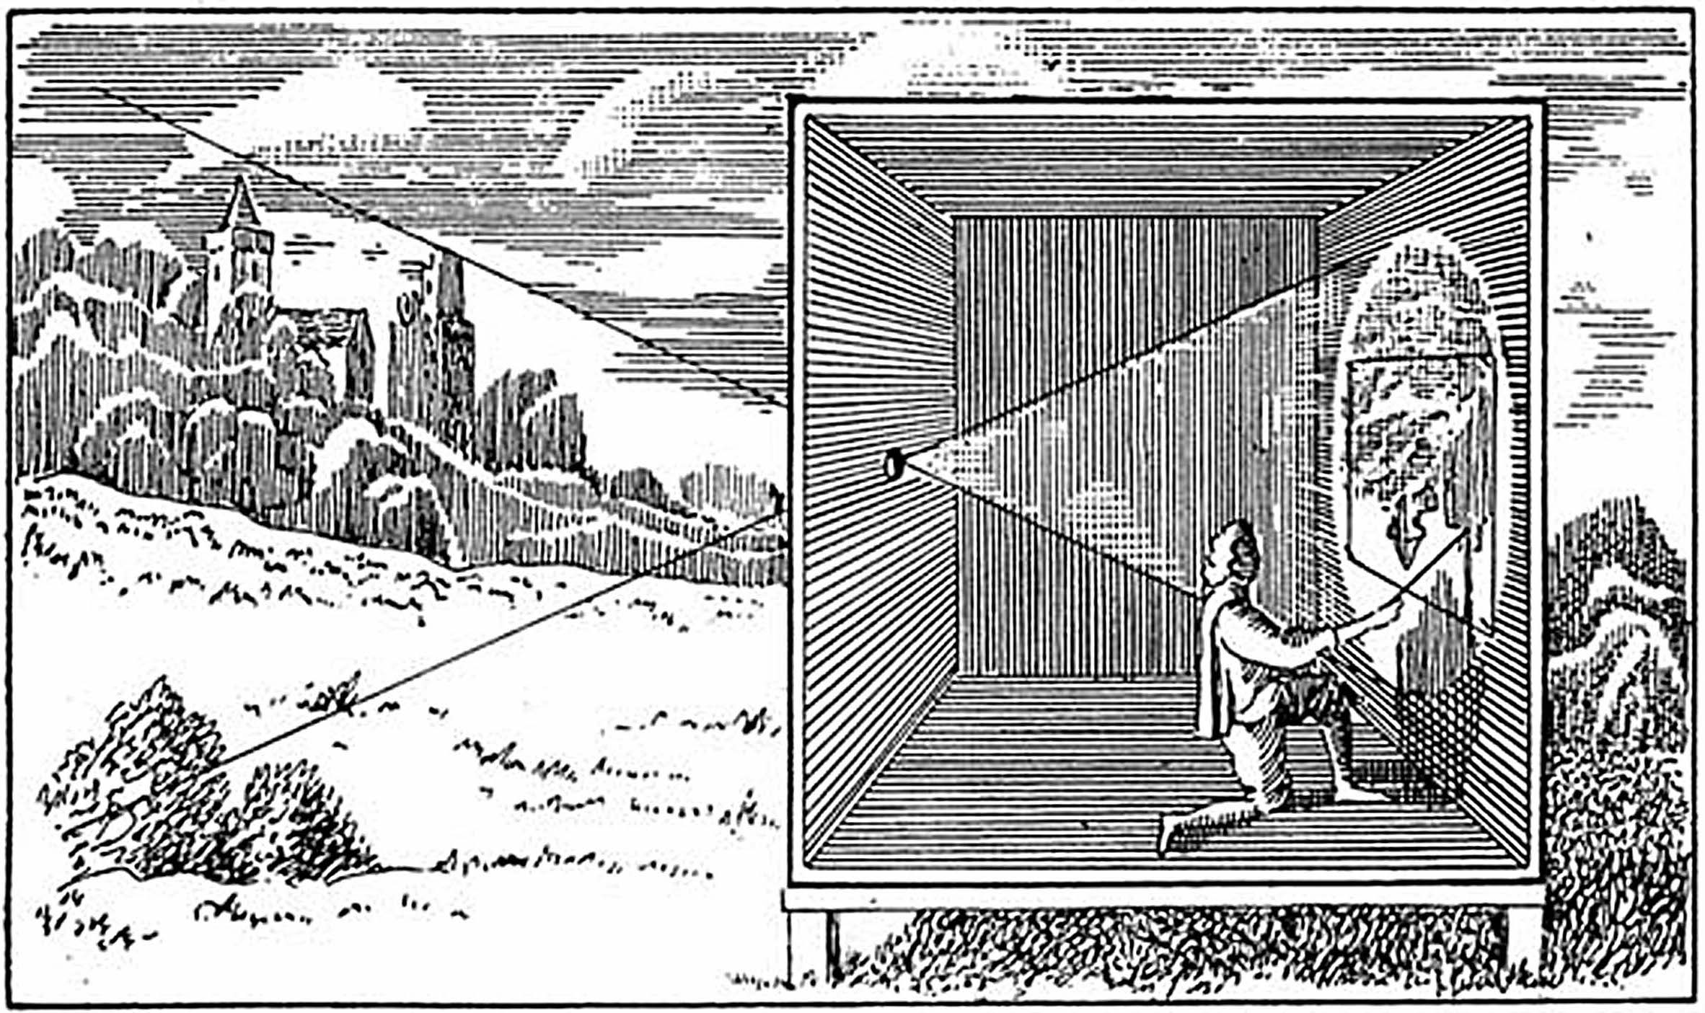
Camera obscura

Slide 7
Camera obscura
https://www.youtube.com/watch?v=LutIudRhm10

Slide 8
history
The first successful permanent photograph was made in France in 1862 by Joseph Nicephore Niepce (1765-1833)
Used a camera obscura to capture images on metal plates
In 1826, Louis Jacques Mande Daguerre built on Niepce idea inventing the daguerreotype in 1839

Slide 9
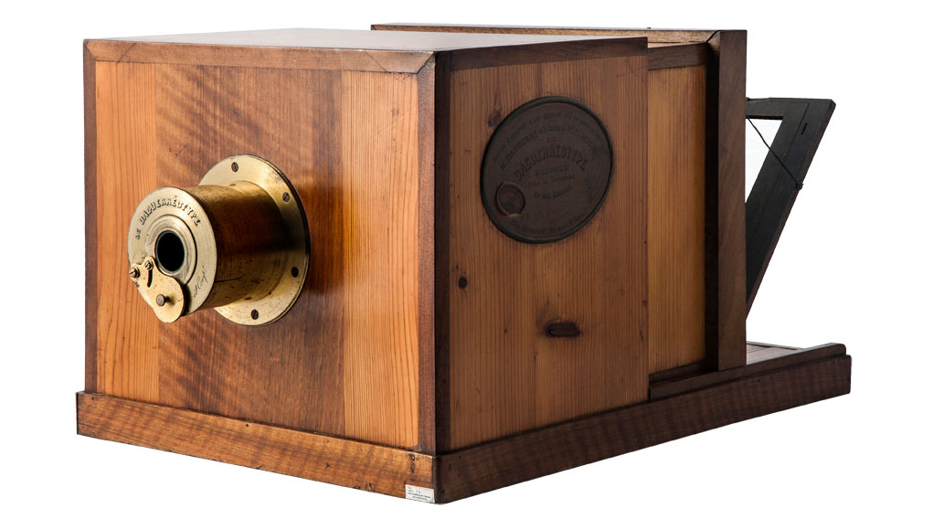
Daguerreotype camera

Slide 10
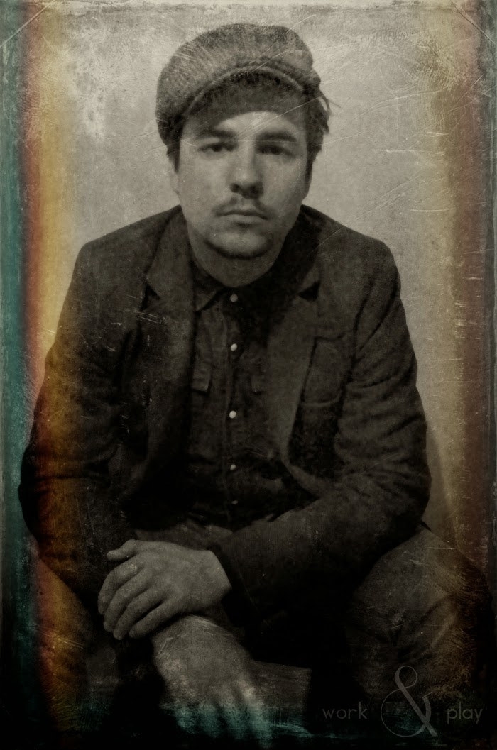
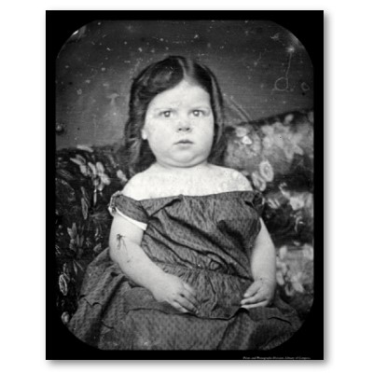
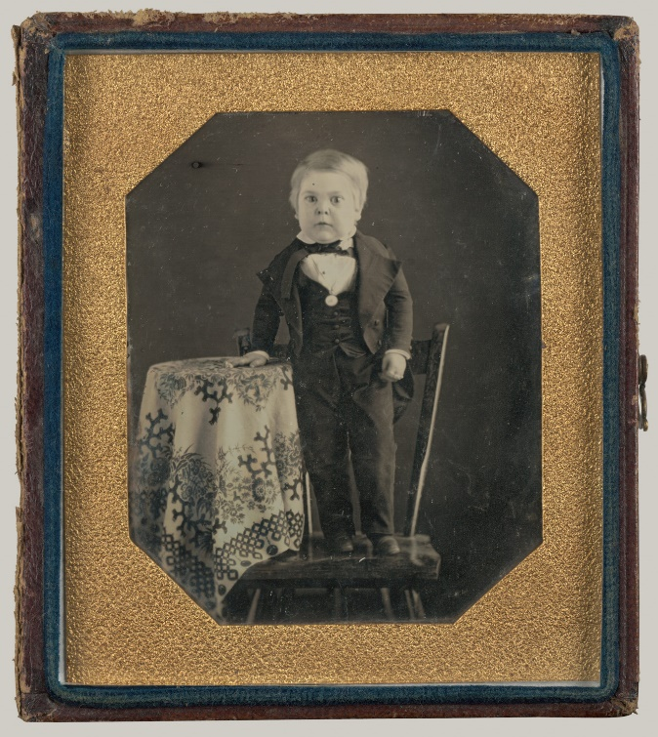
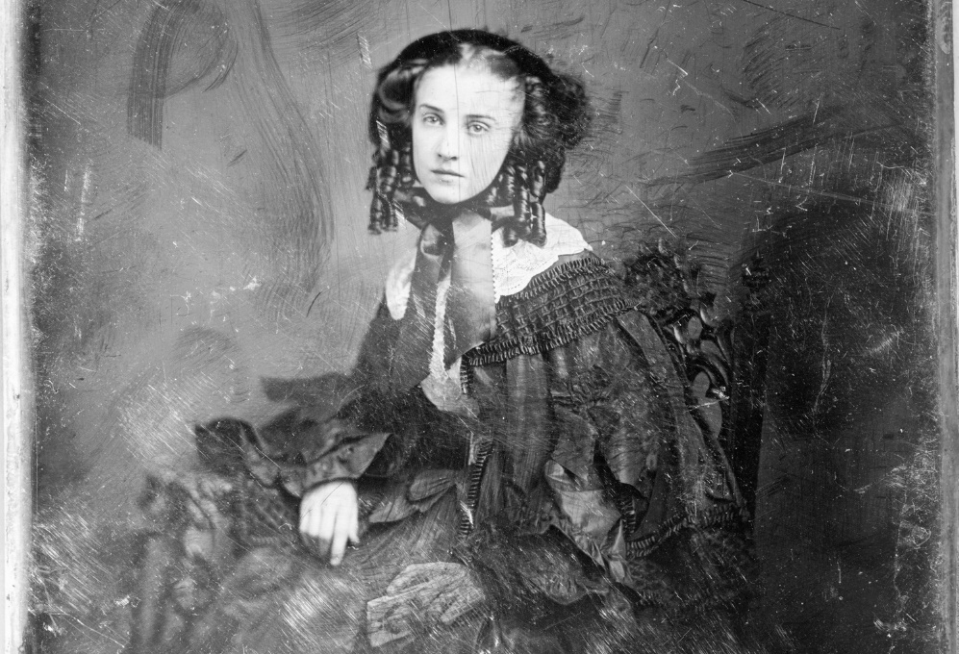

Slide 11
Photography today
Think about where we have come from
Digital cameras
Film camera
Mobile Devices
Product development
Photojournalism

